Slide 1
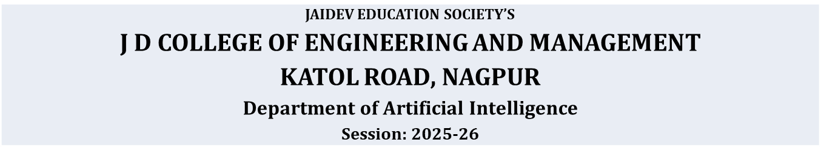

Deep Learning
Prof. Gajanan Wankhade

Slide 2
Introduction to Deep Learning
Evolution of AI
ML vs DL
Neural Networks
Training Algorithms

Slide 3
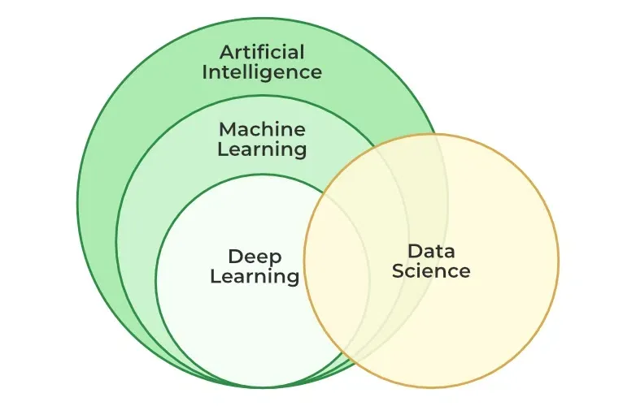
Introduction to Deep Learning

Slide 4
Evolution of AI
Rule-based AI
Machine Learning
Deep Learning

Slide 5
Machine Learning vs Deep Learning
Manual features vs Automatic features
Shallow vs Deep models

Slide 6
What is Deep Learning?
Uses multi-layer neural networks
Learns hierarchical features

Slide 7
Types of Deep Learning
Supervised
Unsupervised
Reinforcement Learning

Slide 8
History of Deep Learning
1943 MP Neuron
1958 Perceptron
2012 AlexNet

Slide 9
Artificial Neuron Model
Inputs, Weights, Bias
Activation Function

Slide 10
Activation Functions
Step, Sigmoid, Tanh
ReLU, Softmax

Slide 11
McCulloch Pitts Neuron
Binary inputs and outputs
Threshold logic

Slide 12
Perceptron
Single-layer model
Linear classification

Slide 13
Forward Propagation
Input → Hidden → Output

Slide 14
Back Propagation
Error calculation
Weight update

Slide 15
Gradient Descent
Optimization technique
Minimizes loss

Slide 16
Types of Gradient Descent
Batch
Stochastic
Mini-batch

Slide 17
Applications
Vision, Speech
Healthcare, Robotics

Slide 18
Conclusion
Core of modern AI
Future of intelligent systems

